Slide 1
OBJECT ORIENTED PROGRAMING USING JAVA
SAURABH RASTOGI

Slide 2
Introduction to Java
Java is a popular, high-level, object-oriented programming language known for its portability, security, and robustness. Object-Oriented Programming (OOP) is central to Java, providing a way to structure code using objects and classes.
It is developed by Sun Microsystems (now owned by Oracle Corporation). It is renowned for its "Write Once, Run Anywhere" (WORA) capability, meaning that compiled Java code can execute on any platform that supports a Java Virtual Machine (JVM) without requiring recompilation.

Slide 3
Key characteristics of Java include:
Object-Oriented:
Java follows the object-oriented programming (OOP) paradigm, organizing code into reusable components called objects and classes. This promotes modularity, reusability, and maintainability.
Platform Independent:
Through the JVM, Java achieves platform independence. Code is compiled into bytecode, which the JVM then interprets and executes on the specific operating system.

Slide 4
Key characteristics of Java Cont. :
Simple and Familiar Syntax:
Java's syntax is similar to C and C++, making it relatively easy for developers familiar with these languages to learn.
Secure and Robust:
Java incorporates features like automatic garbage collection and strong memory management, contributing to robust and secure applications. It also includes security features to protect against malicious code.
Multi-threaded:
Java supports multi-threading, allowing programs to perform multiple tasks concurrently, improving performance and responsiveness.
Extensive Libraries and APIs:
Java boasts a vast collection of pre-built libraries and Application Programming Interfaces (APIs), simplifying development for various applications.

Slide 5
Common applications of Java include:
Enterprise Applications: Widely used for large-scale, mission-critical enterprise systems.
Android App Development: The primary language for developing applications for the Android mobile platform.
Web Applications: Used for building server-side components of web applications, often with frameworks like Spring and Java EE.
Desktop Applications: Capable of creating cross-platform desktop applications.
Big Data Technologies: Plays a role in various big data frameworks and tools.

Slide 6
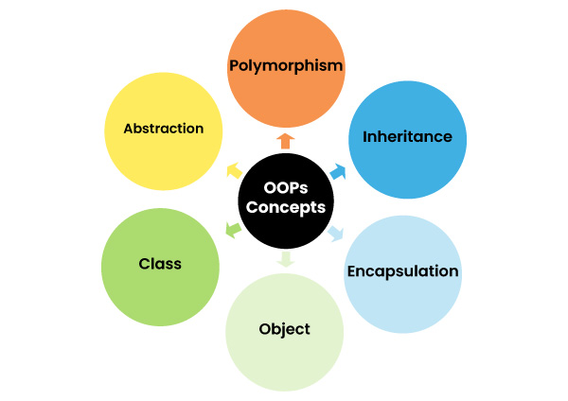
Object Oriented Programing Concepts

Slide 7
Class :
A class is a blueprint for creating objects. It defines properties (fields) and methods (functions).
public class Car {
String color;
void drive() {
System.out.println("Car is driving");
}
}

Slide 8
Key aspects of a Java class:
Declaration: A class is declared using the class keyword, followed by the class name, and a body enclosed in curly braces {}.
Java
public class ClassName {
// class body: fields, constructors, methods
}
Fields (Attributes/Instance Variables):
These are variables declared within the class that hold data specific to each object created from that class.
Methods:
These are functions defined within the class that represent the behaviors or actions an object of that class can perform.
Constructors:
Special methods used to initialize objects when they are created.
They have the same name as the class and do not have a return type.
Objects (Instances):
An object is a concrete realization or instance of a class. When an object is created,
it allocates memory to store its specific field values and can invoke the methods defined in its class.

Slide 9
OBJECT
Definition: An object is an instance of a class. It represents a real-world entity with state and behavior.
EXAMPLE
Car myCar = new Car();
myCar.color = "Red";
myCar.drive();

Slide 10
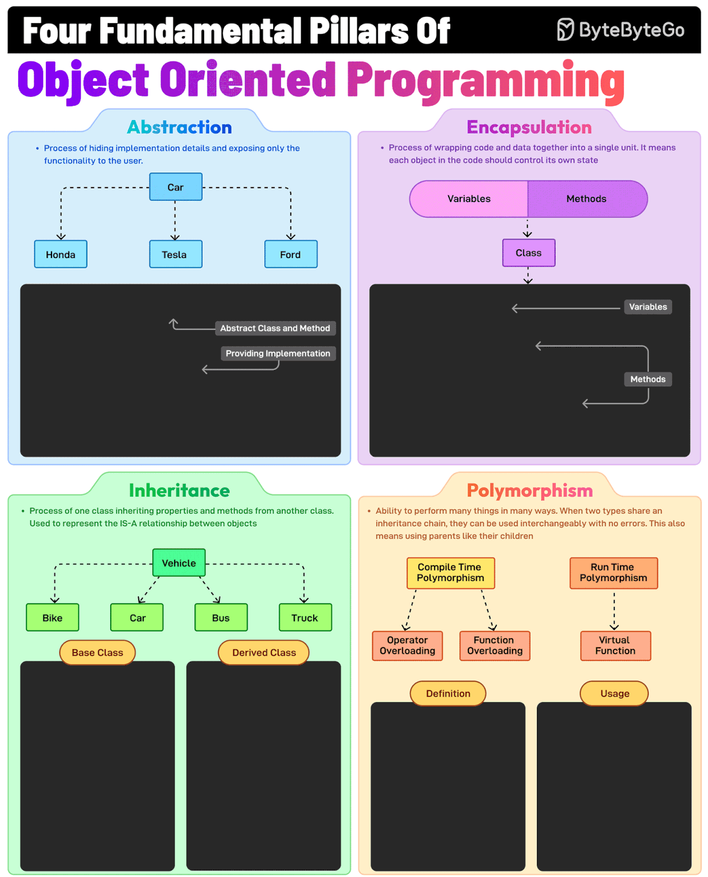

Slide 11
Abstraction
Definition: Abstraction hides complex implementation details and exposes only essential features of an object.
EXAMPLE :
abstract class Animal {
abstract void makeSound();
}
class Dog extends Animal {
void makeSound() {
System.out.println("Woof");
}
}
// Only the action is exposed, not HOW sound is made.

Slide 12
Encapsulation
Definition: Encapsulation bundles data (fields) and methods operating on the data into a single unit (class) and restricts direct access to some components.
EXAMPLE :
public class Account {
private double balance;
public void deposit(double amount) {
balance += amount;
}
public double getBalance() {
return balance;
}
}
// balance can't be changed directly from outside; access is controlled.

Slide 13
ABSTRACTION VS ENCAPSULATION
ABSTACTION
ENCAPSULATION
Abstraction is process of hiding the implementation details and showing only the functionality to the users.
Main feature: reduce complexity, promote maintainability, and also provide clear separation between the interface and its concrete implementation.
In abstraction, problems are solved at the design or interface level.
Abstraction provides access to specific part of data.
Abstraction focuses on "what" the object does .
Encapsulation is a process of binding data and methods together in a single unit, providing controlled access to data.
Main feature: data hiding, providing access control and modularity.
While in encapsulation, problems are solved at the implementation level.
Encapsulation hides data, preventing the users from directly accessing it, (providing controlled access) which is also known as data hiding.
Encapsulation focuses on "How" the object does it.

Slide 14
ACCESS SPECIFIERS
There are four types of access specifiers in Java:
public:
  Accessibility: Members declared as public are accessible from any other class, regardless of the package.
  Usage: Typically used for methods and fields that are intended to be part of a class's public API.
private:
  Accessibility: Members declared as private are only accessible within the class in which they are declared.
  They cannot be accessed from outside the class, even by subclasses.
  Usage: Primarily used for data hiding and encapsulating internal implementation details of a class.
protected:
  Accessibility: Members declared as protected are accessible within the same package and by subclasses, even if those subclasses are in a different package.
  Usage: Useful when you want to allow subclasses to access certain members while preventing access from unrelated classes outside the package.
default (package-private):
  Accessibility: When no access specifier is explicitly defined, the member has default or package-private access. This means it is only accessible within the same package.
  Usage: Suitable for members that are only intended for use by other classes within the same logical unit (package).

Slide 15
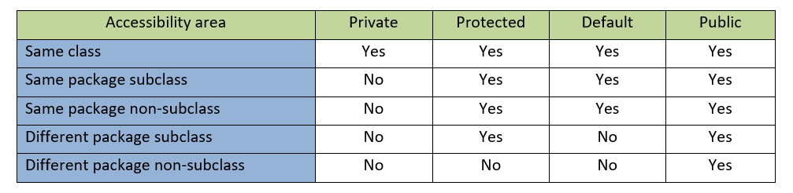
ACCESS SPECIFIERS CONTD.

Slide 16
INHERITENCE
Definition: Inheritance allows a class to inherit fields and methods from another class, promoting code reuse.
EXAMPLE
class Animal {
void eat() {
System.out.println("Eating");
}
}
class Dog extends Animal {
void bark() {
System.out.println("Barking");
}
}
// Dog has both eat() and bark() methods.

Slide 17
POLYMORPHISM :
Polymorphism means "many forms." It allows one interface to be used for different data types or classes.
EXAMPLE
class Animal {
void makeSound() {
System.out.println("Some sound");
}
}
class Cat extends Animal {
void makeSound() {
System.out.println("Meow");
}
}

Slide 18
Polymorphism contd.
class Dog extends Animal {
void makeSound() {
System.out.println("Woof");
}
}
// Usage:
Animal a1 = new Cat();
Animal a2 = new Dog();
a1.makeSound(); // Meow
a2.makeSound(); // Woof

Slide 19
SUMMARY
Concept | Definition | Example (Java Code)
Class | Blueprint for objects | public class Car { ... }
Object | Instance of a class | Car myCar = new Car();
Abstraction | Hides complexity, shows essentials | abstract class Animal { abstract void makeSound(); }
Encapsulation | Bundles data and methods, restricts access | private double balance; public void deposit(...) {...}
Inheritance | Acquires properties from another class | class Dog extends Animal { ... }
Polymorphism | One interface, many forms | Animal a = new Dog(); a.makeSound(); // Woof

